Slide 1
Shallow Water Equations with Pseudo Spectral Method
Christopher Lawrence
27 February 2019

Slide 2
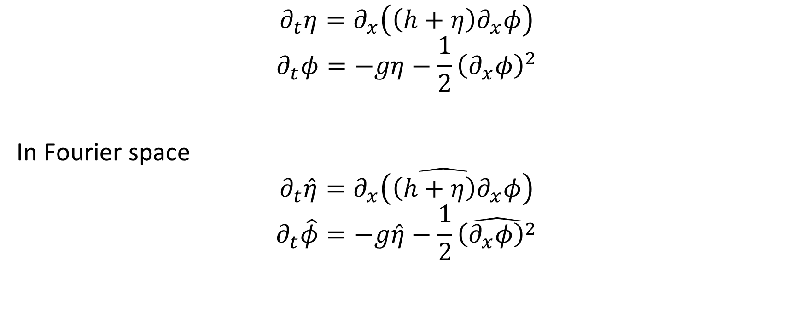
Shallow Water Equations
$$∂_{t}η=∂_{x}\left(\left(h+η\right)∂_{x}φ\right)$$
$$∂_{t}φ=−gη−\frac{1}{2}{\left(∂_{x}φ\right)}^{2}$$
In Fourier space
$$∂_{t}\hat{η}=\hat{∂_{x}\left(\left(h+η\right)∂_{x}φ\right)}$$
$$∂_{t}\hat{φ}=−g\hat{η}−\frac{1}{2}\hat{{\left(∂_{x}φ\right)}^{2}}$$

Slide 3
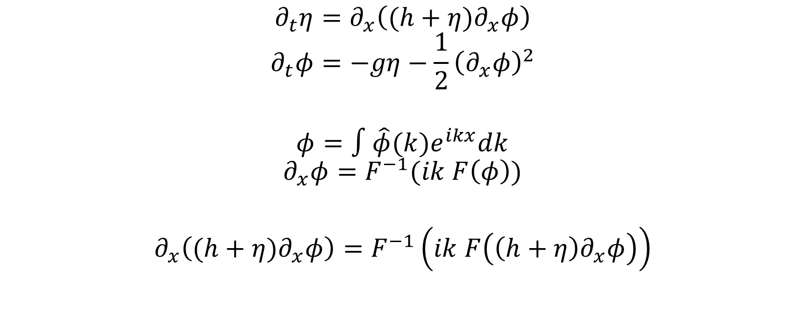
Pseudo Spectral Method in NSWE
$$∂_{t}η=∂_{x}\left((h+η)∂_{x}φ\right)$$
$$∂_{t}φ=−gη−\frac{1}{2}{\left(∂_{x}φ\right)}^{2}$$
$$φ=∫\hat{φ}(k)e^{ikx}dk$$
$$∂_{x}φ=F^{−1}(ik F\left(φ\right))$$
$$∂_{x}\left((h+η)∂_{x}φ\right)=F^{−1}\left(ik F\left(\left(h+η\right)∂_{x}φ\right)\right)$$

Slide 4
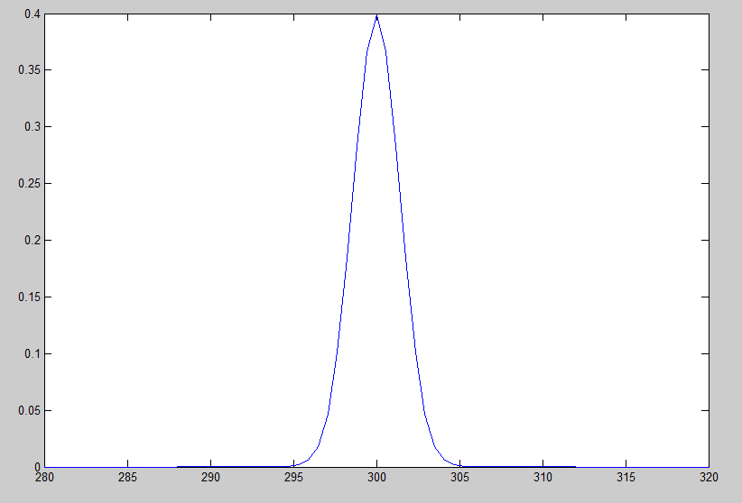
Simulation with initial condition
Depth = 1
Gaussian profile with amplitude 0.4

Slide 5
LSWE

Slide 6
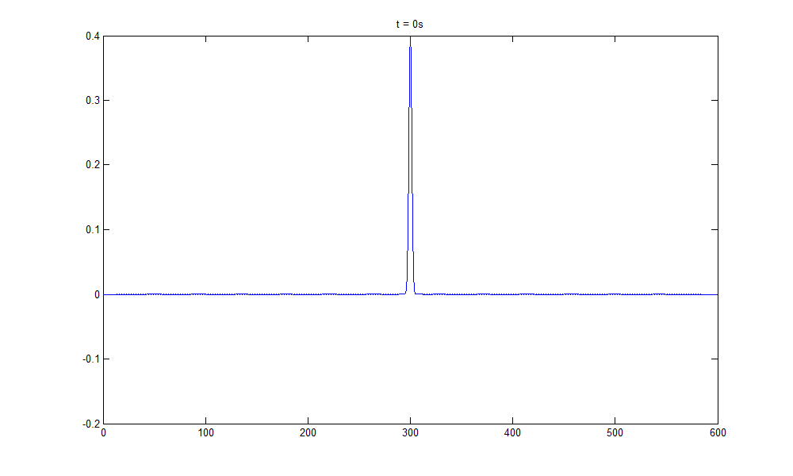

Slide 7
NSWE

Slide 8
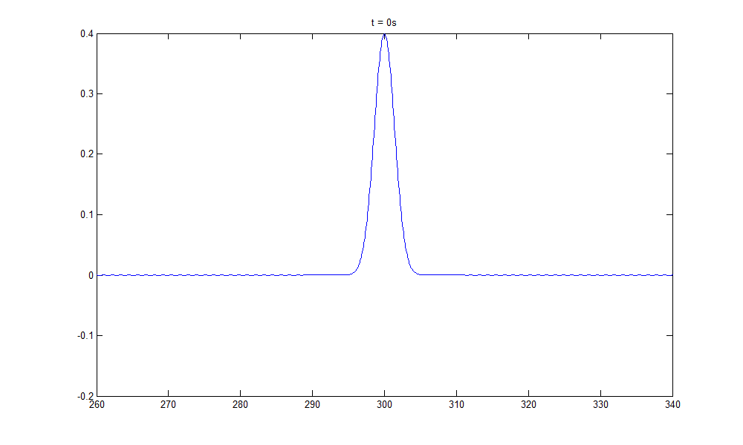

Slide 9
Linear Wave Theory (Airy)

Slide 11
High Order Spectral Method (Third order)

